Slide 1

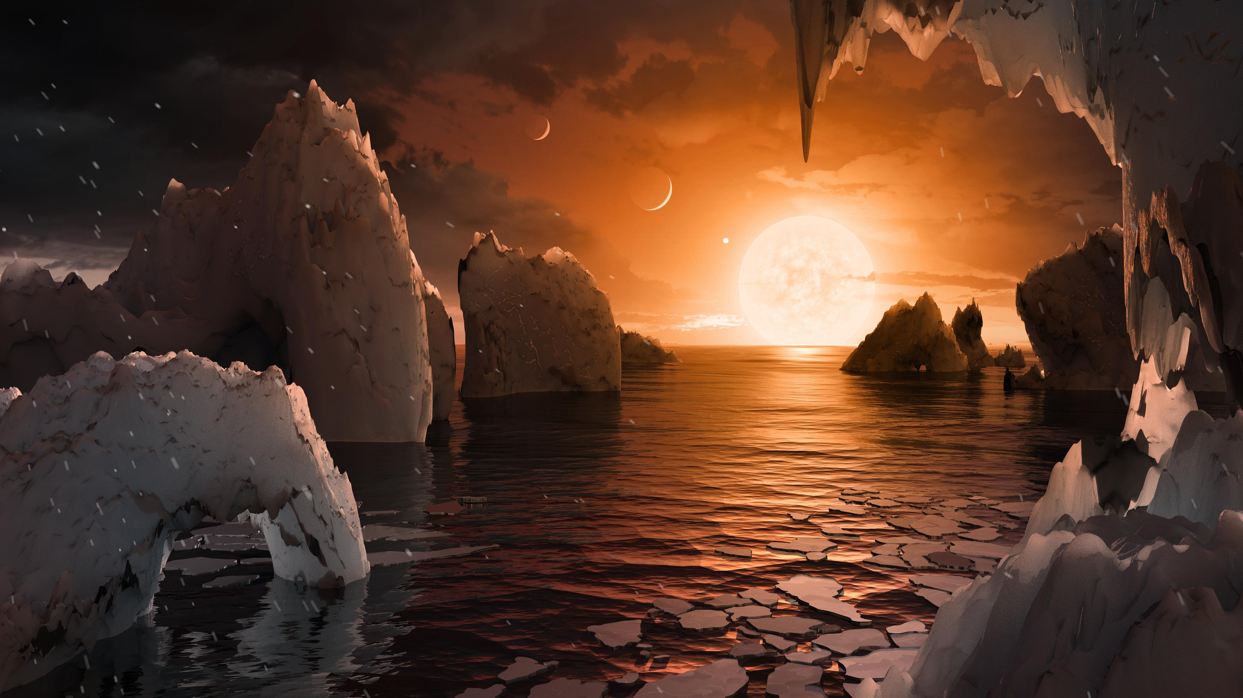




Exploring the Capability of the James Webb Space Telescope to Characterize Exoplanet Atmospheres
PI: Megan Gialluca (mtg224@nau.edu)
Mentor: Tyler Robinson (Tyler.Robinson@nau.edu)
Notes:
Intro

Slide 2
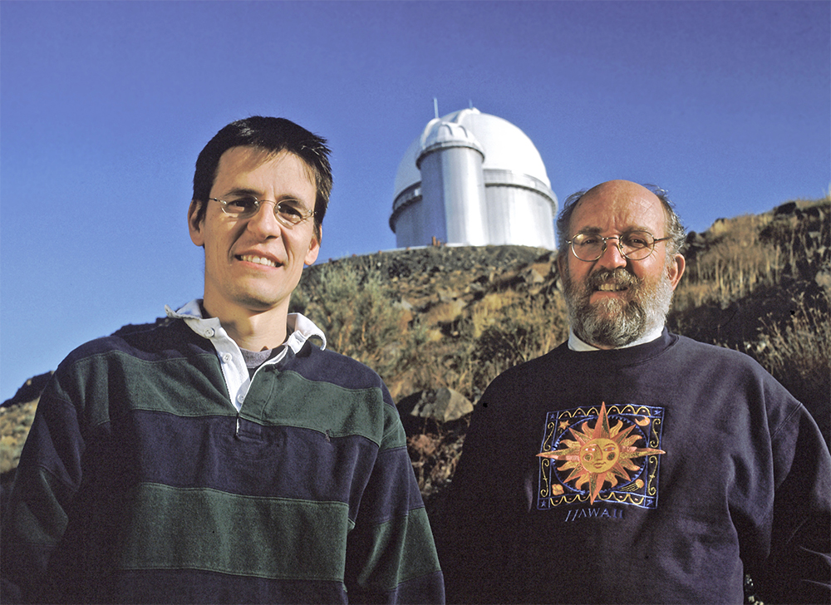
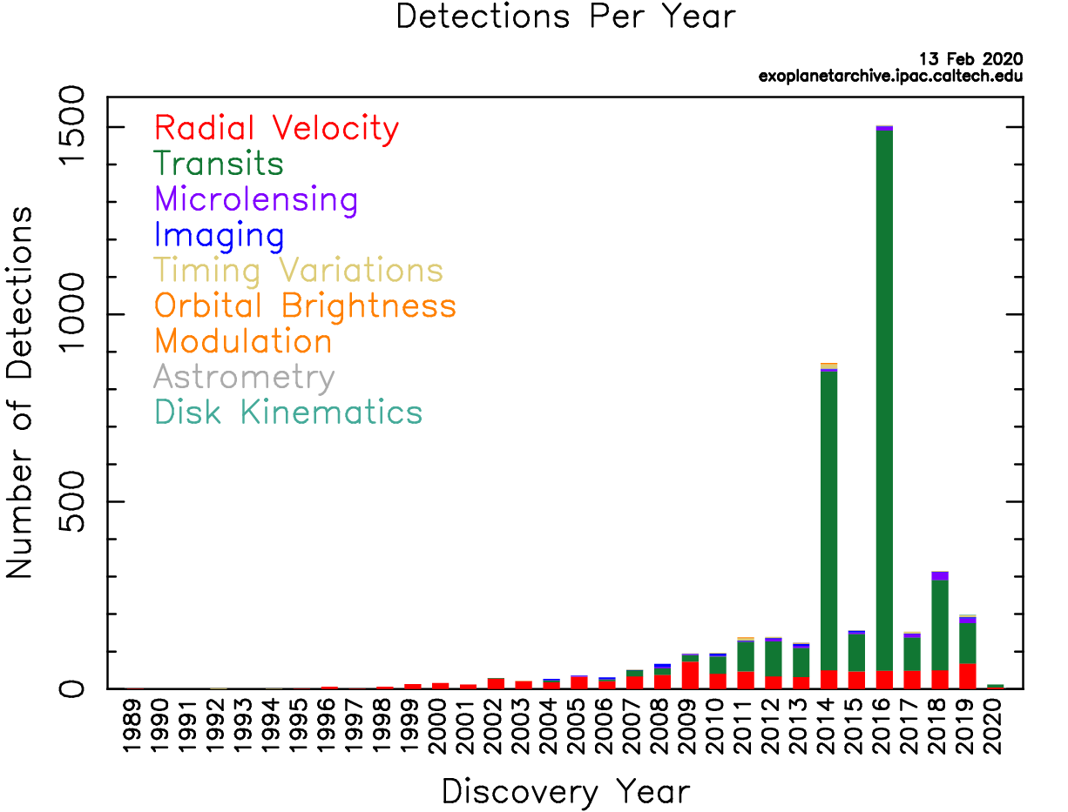
Background
Exoplanet:
A planet orbiting a star that is not our sun (from Merriam-Webster)
Didier Queloz (left) and Michel Mayor (right), discoverers of the first exoplanet: 51 Pegasi B
Photo: Exoplanets.nasa.gov
Above Histogram shows the number of exoplanets discovered per year grouped by discovery method. Taken from the NASA Exoplanet Archive.

Slide 3
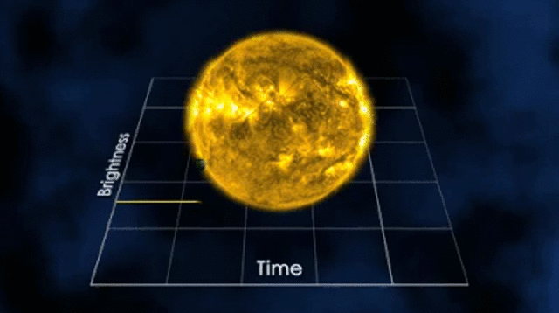



Background
R
Total Flux Received:
$$F_{λ}∝π{R_{⋆}}^{2}B_{λ}(T_{⋆})$$
r
R
Total Flux Received:
$$F_{λ}∝π{R_{⋆}}^{2}B_{λ}\left(T_{⋆}\right)−π{R_{p}}^{2}B_{λ}\left(T_{⋆}\right)$$
Gif: Nasa.gov
Transit Method
$F_{λ}$ - Wavelength Dependent Flux
$R_{⋆}$ - Stellar Radius (R)
$R_{p}$ - Planetary Radius (r)
$B_{λ}(T_{⋆})$ - Planck’s Function of the Stellar Temperature

Slide 4
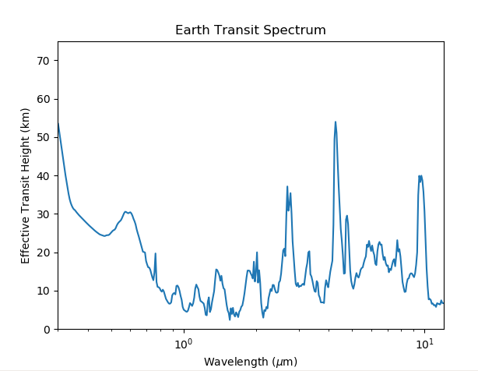
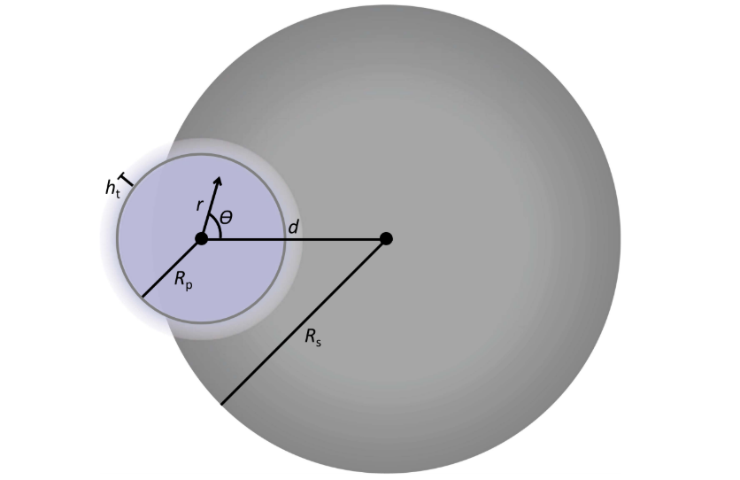








Background
Star
OBSERVER
$${CO}_{2}$$
$$O_{3}$$
$$O_{3}$$
$$O_{3}$$
$$H_{2}O$$
$$O_{2}$$
$${CH}_{4}$$
$$H_{2}O$$
$${CH}_{4}$$
$$H_{2}O$$
$${CO}_{2}$$
[1]
[1] Robinson, Tyler D. The Astrophysical Journal 836.2 (2017): 236.

Slide 5
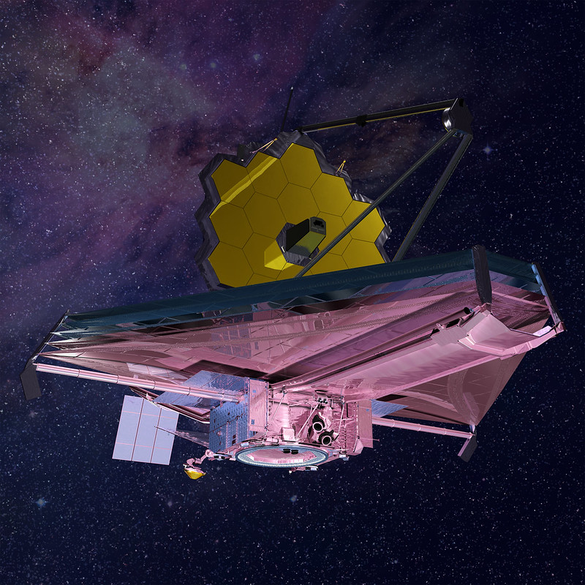
Background
Instruments Aboard:
Near Infrared Spectrograph (NIRSpec)
  0.6 – 5.3 µm
Mid Infrared Instrument (MIRI)
  Low Resolution: 5 – 12 µm
  Med Resolution: 4.9 – 28.8 µm
Near Infrared Camera (NIRCam)
  a) 2.5 – 5 µm
Near Infrared Imager and Slitless Spectrograph (NIRISS)
  Single Object: 0.6 – 2.8 µm
  Wide Field: 0.8 – 2.2 µm
nasa.gov/mission_pages/webb

Slide 6
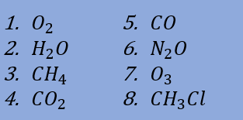
Goal:
To evaluate the atmospheric categorization capabilities of the James Webb Space Telescope.
Research Question:
What is the minimum number of transits the James Webb must observe in order to detect key biosignatures (a gas species that could indicate habitability) in the atmospheres of Earth-like planets orbiting seven different stellar hosts
Stellar Hosts:
Biosignatures:
Trappist 1
Gl1214
Gl436
Gl581
Gl667
Gl832
Gl876

Slide 7
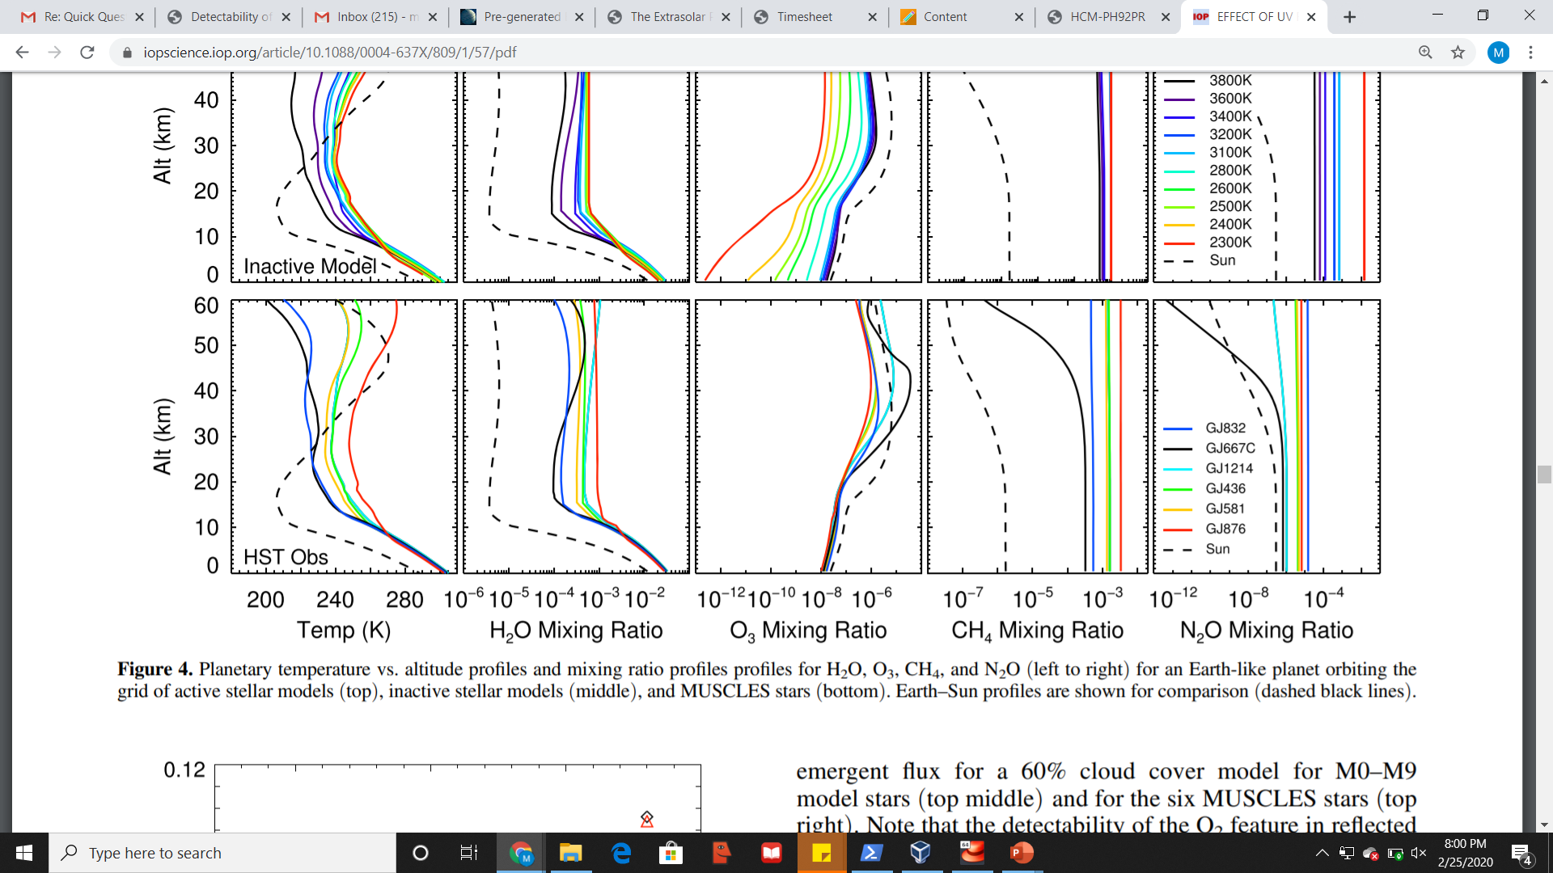
Atmospheric Data
SMART
[3]
Transit Files
JWST Noise Model
[2]
[4]
Signal to Noise Ratio
[2] Rugheimer, S., et al. The Astrophysical Journal 809.1 (2015): 57. [3] Meadows, Victoria S., and David Crisp. Journal of Geophysical Research: Planets 101.E2 (1996): 4595-4622. [4] Thanks to the JWST User Documentation for data used in Noise Model

Slide 8
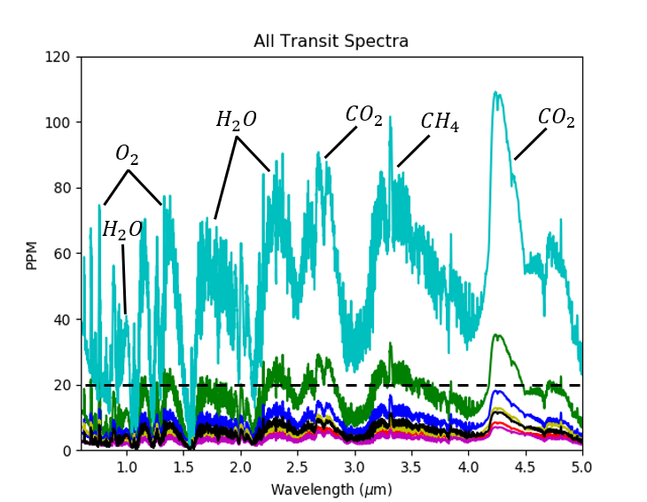
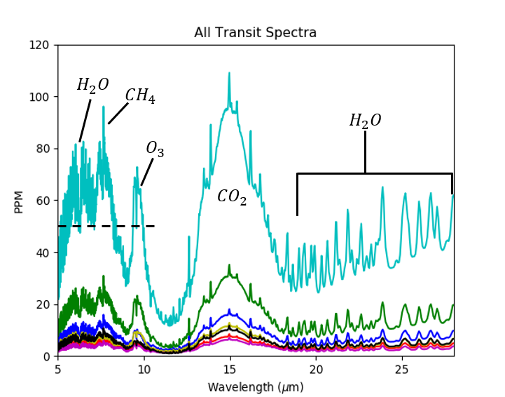
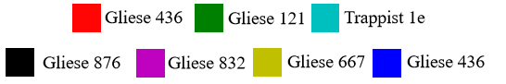
Atmospheric Data
SMART
Transit Files
JWST Noise Model
Signal to Noise Ratio

Slide 9
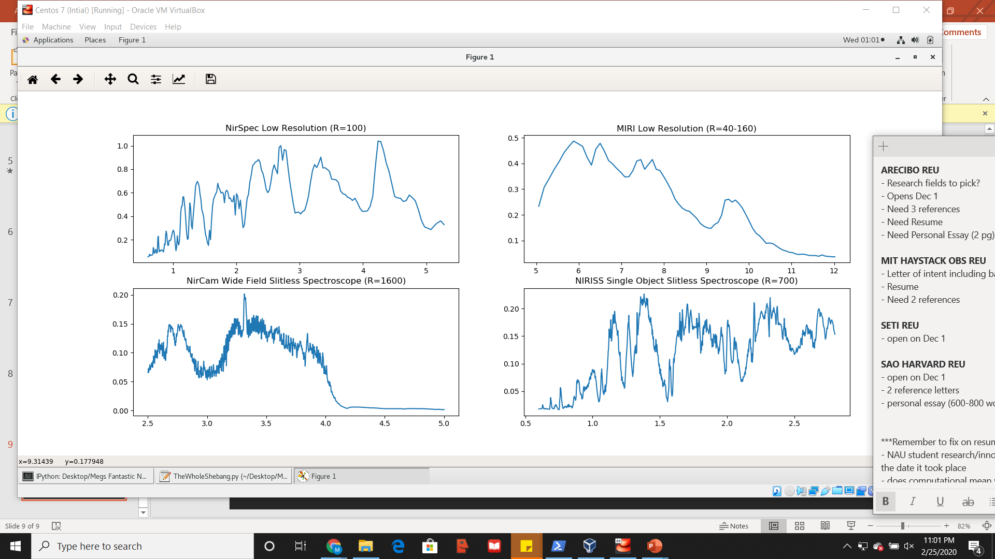
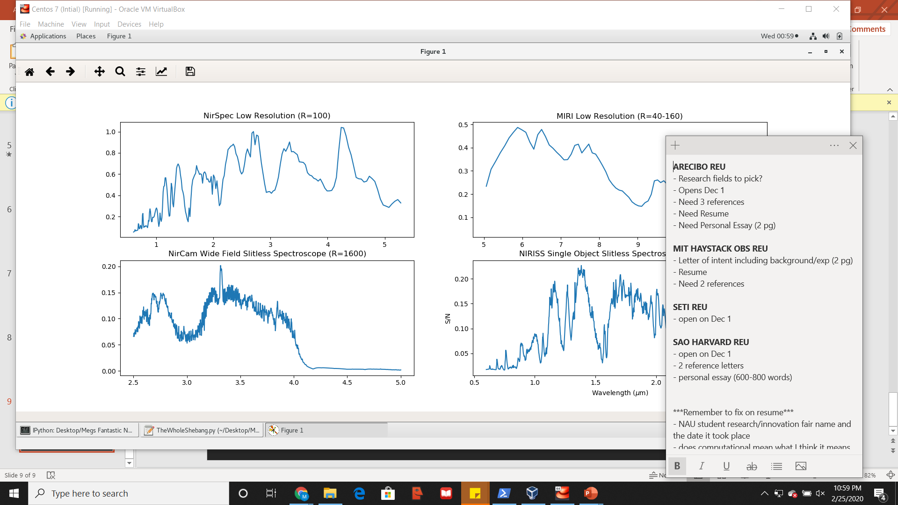
Atmospheric Data
TRAPPIST-1e Signal to Noise Ratios of 1 Transit
SMART
Transit Files
JWST Noise Model
Signal to Noise Ratio

Slide 10
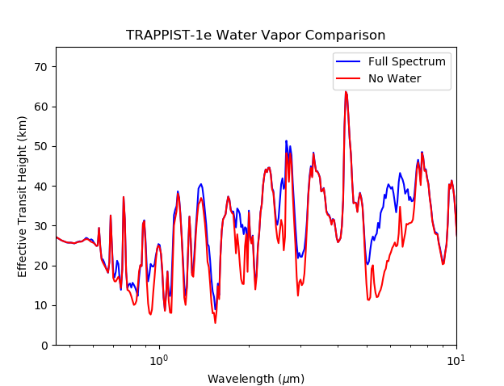
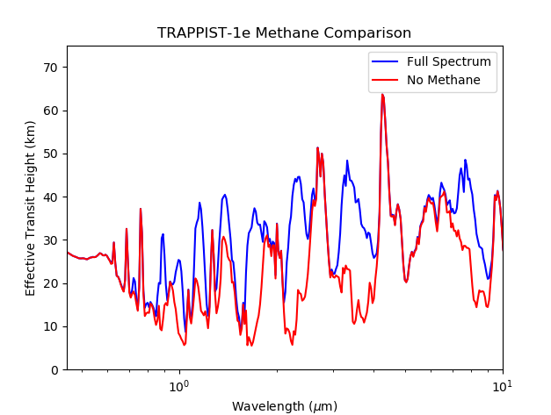
Atmospheric Data
(Missing a gas)
SMART
Transit Spectra (Missing a gas)
Transit Spectra Comparisons

Slide 11
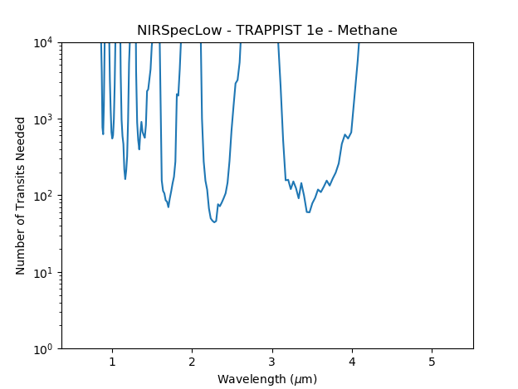
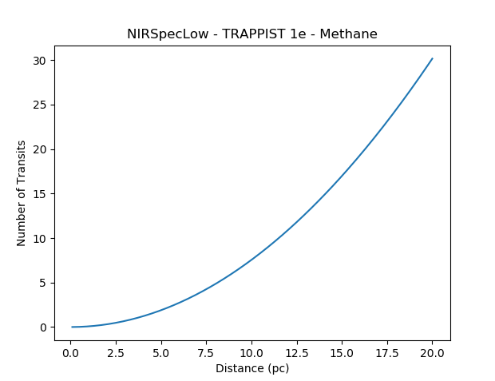
Signal to Noise Ratio
Transit Spectra Comparisons
# of Transits Required

Slide 12
Add HURA Logo
Next Steps:
Determine best case (minimum number of transits needed to detect each gas species for each stellar host considering all instruments and observing modes)
Write and publish paper
Acknowledgments:
Special thanks to the NASA/NAU Space Grant for funding and support
Thanks to Dr. Sarah Rughemier for sharing atmospheric data
Thanks to the Hooper Undergraduate Research Award for previous project funding
Thanks to Dr. Tyler Robinson for continued guidance and collaboration

